Slide 1
Domain Driven Design
There is nothing called no design.

Slide 2
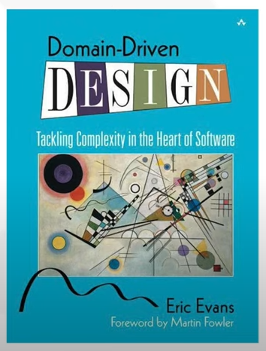
What is Domain Driven Design?
Domain Driven Design is a way of looking at software from top down.
When we are developing a software our focus shouldn’t be primarily on technology, it should be primarily on business or whatever activity we are trying to assist with the software, the domain.
Specifically we approach that by trying to develop models of that domain and make our software conformed to that.
Collection of principles and patterns that help developers craft elegant systems.
A Model driven software design approach used to tackle the complexity of software projects.

Slide 3
Focus On Design
As a software developer, we have a habit of viewing the software as simply objects and methods.
Will you create a great art, if you only concentrate on brushes, colors and canvas or a great car just by thinking of it as collection of engine parts ?
A good car, or art or house start with an vision, a theme.
It starts with carefully writing down the specification and continues with design a lot of design… a lot of it ☺.
Don’t try to deliver perfect design in first attempt, it takes time, refinement, refactoring, revisiting, restructuring… a lot of it.

Slide 4
What does DDD give us?
Tactical Design Tools
Service
Project
Strategic Design Tools
Layers
Domain
Modules
Sub-Domain
Sub-Domain
Sub-Domain
Design Patterns
Service
Service
Service
OOP
Classes
Objects
Exe/Jar/Zip

Slide 5
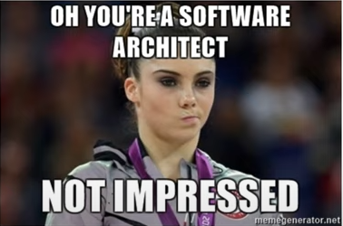
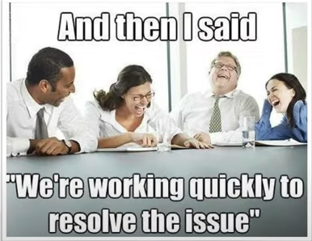
Why should I learn DDD?
To improve your craft
It’s not customer’s job to know what they want – Steve Jobs
Your architecture might be fabulous but it’s the end user ultimately who decides whether your system is fabulous or not.
A system that doesn’t solve the business needs, is of no use to anyone, no matter how pretty it looks or how well architected its infrastructure.

Slide 6
The Participants
Domain Expert :The domain expert is the person who has the knowledge of the system or domain for which the software has to be developed .They would require a product that will help them work on their projects better and hence they require Software Developers.
Developer : The developer is responsible to take in requirements from the Domain Expert and model a software according to their needs.
Domain experts and the developers together are equally responsible towards a final product when using the Domain Driven Design ideology.

Slide 7
DDD: Strategic Design

Slide 8
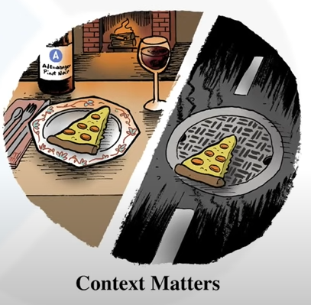
What is Strategic Design ?
Object Oriented Design : Think in terms of objects
Strategic Design : Think in terms of Contexts.
What is Context ?
The setting in which a word or statement appears that determines its meaning.
Context Matters

Slide 9
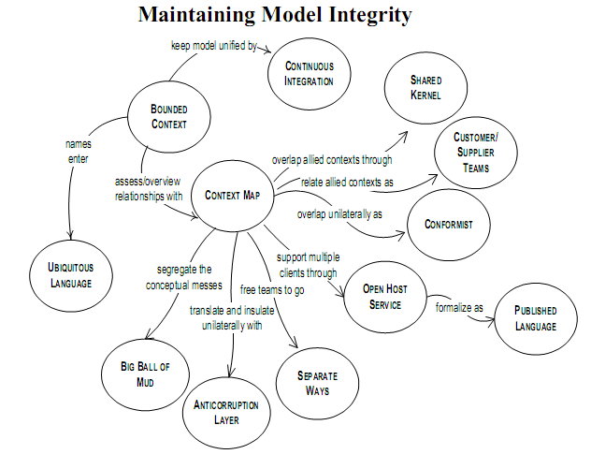
Strategic Design Tools

Slide 10
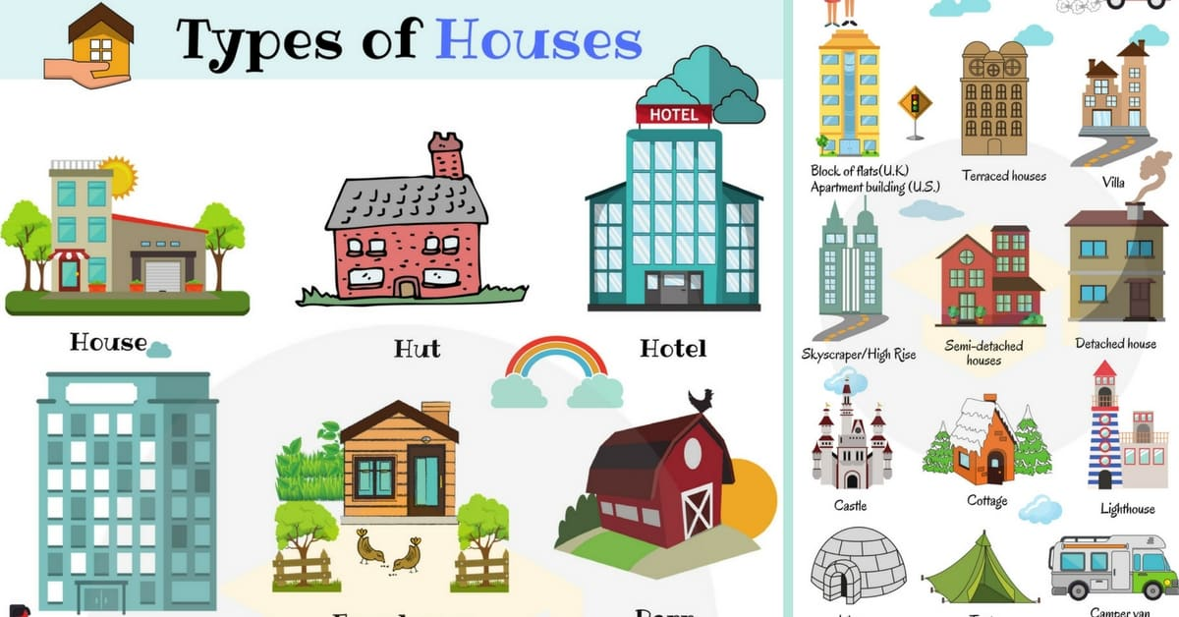
Build A House
What kind of house ?
You will talk to domain expert
You’ll try to find out the core values
You’ll see what others have done right or wrong

Slide 11
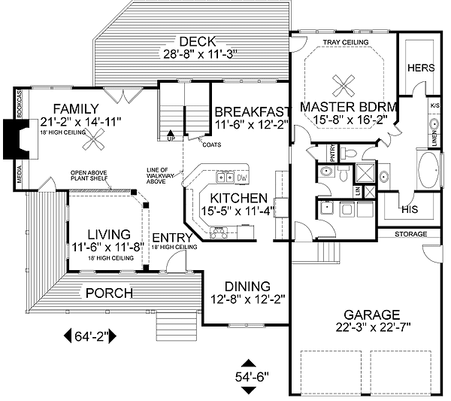

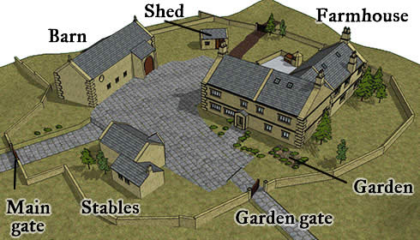
Domain Model
Domain
Bounded Contexts
Ubiquitous Language
Domain model is to a bounded context,
what classes are to an object.
Domain model refers to the abstraction
Of the sub domain.
It is an interpretation of reality.
Context Map
Sub - Domains

Slide 12
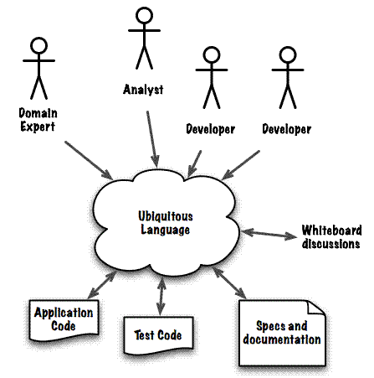
Ubiquitous Language
The vocabulary of a given business domain, not only in discussions about the requirements for a software product, but in discussions of design as well and all the way into "the product's source code itself".

Slide 13
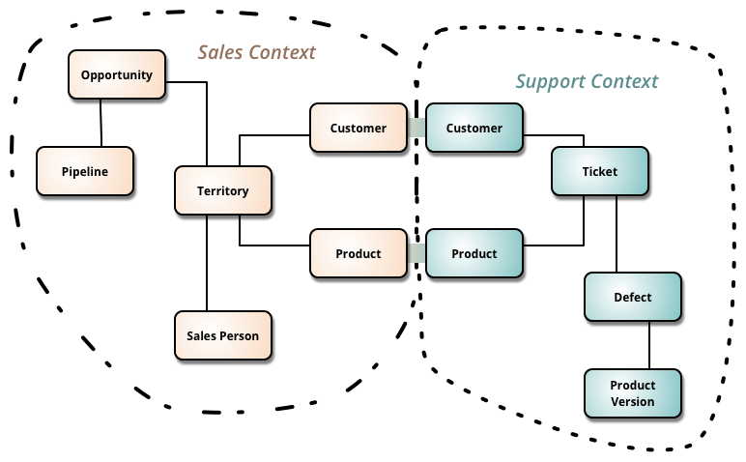
Bounded Context
Each bounded context has its own domain model and
Its own ubiquitous Language.
Multiple models are in play on any large project. Yet when code based on distinct models is combined, software becomes buggy, unreliable, and difficult to understand. Communication among team members becomes confusing. It is often unclear in what context a model should not be applied.
Therefore: Explicitly define the context within which a model applies. Explicitly set boundaries in terms of team organization, usage within specific parts of the application, and physical manifestations such as code bases and database schemas. Keep the model strictly consistent within these bounds, but don’t be distracted or confused by issues outside.

Slide 14
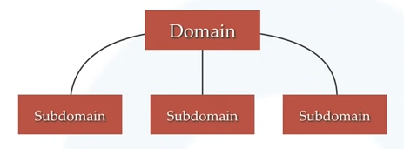
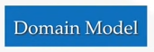
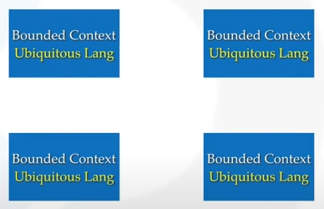
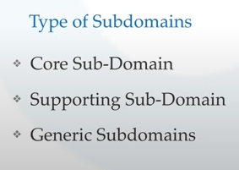
Problem Space
Solution Space
Context Map

Slide 15
Context Relationship Types
Published Language : The interacting BCs agree on a common language (e.g., XML schemas over an enterprise bus) by which they can interact with each other.
Open Host Service : BC specifies a protocol (e.g. RESTful web service) by which any other BC can use its services.
Shared Kernel : 2 BCs use a common kernel of code (e.g. a library) as a common lingua-franca, but otherwise do their other stuff in their own way.
Customer/Supplier : One BC uses the services of another and is a stakeholder (customer) of other BC. As such it can influence the services provided by that BC.
Conformist : One BC uses the services of another but is not a stakeholder to that other BC. As such it uses “as-is” (conforms to) the protocols or APIs provided by that BC.
Anti-Corruption Layer: One BC uses the services of another and is not a stakeholder, but aims to minimize impact from changes in the BC it depends on by introducing a set of adapters.

Slide 16
DDD: Tactical Design

Slide 17
What are Tactical Design tools?
Tactical design tools are connected with implementation details.
Generally takes care of components inside a bounded context.
A de facto standard in development world.
Some of them are : services, entities, repositories, factories.
They’ve all been made popular by DDD.
Contrary to strategic design, tactical design is expected to change during product development.

Slide 18
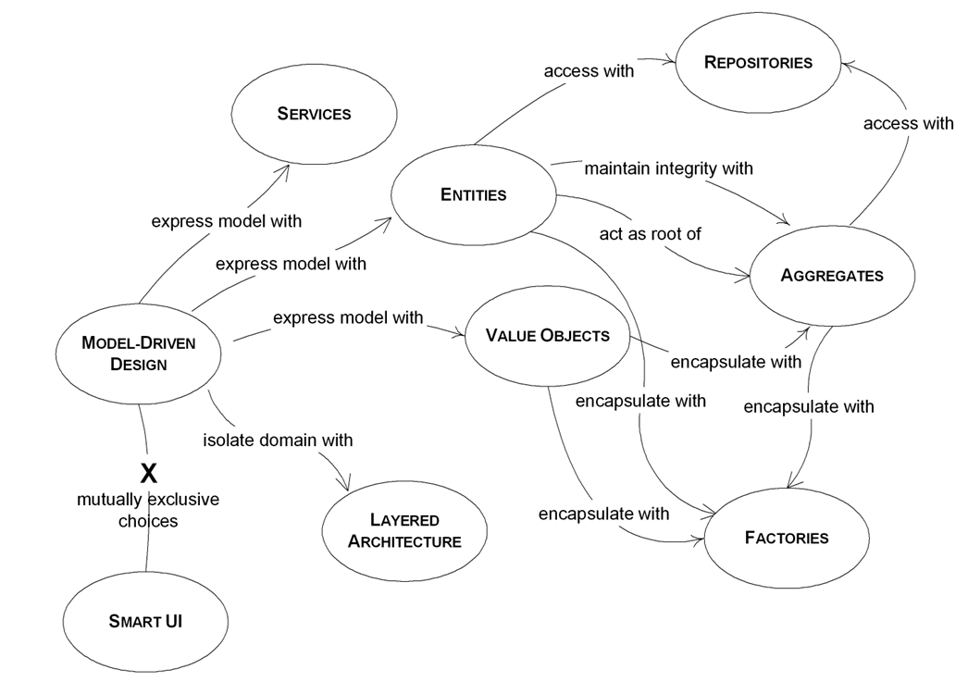
Tactical Design

Slide 19
Model Driven Design
Domain
Domain
Service
Service
Service
Service
Service
Sub-Domain
Bounded Context
Domain Model
Ubiquitous Language
Sub-Domain
Bounded Context
Domain Model
Ubiquitous Language
Sub-Domain
Bounded Context
Domain Model
Ubiquitous Language
Sub-Domain
Bounded Context
Domain Model
Ubiquitous Language
Sub-Domain
Bounded Context
Domain Model
Ubiquitous Language
Sub-Domain
Bounded Context
Domain Model
Ubiquitous Language

Slide 20
Tactical Design

Slide 21
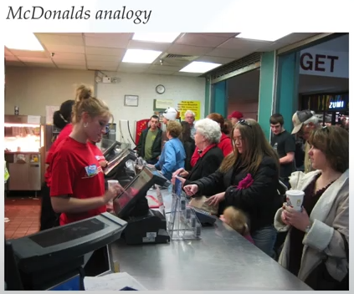
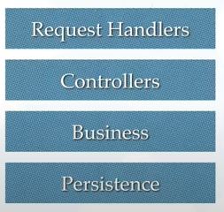
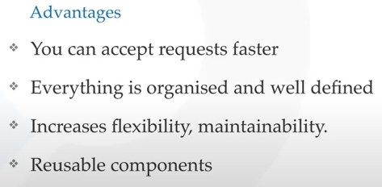
Layered Architecture

Slide 22
Tactical Design

Slide 23
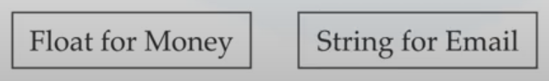
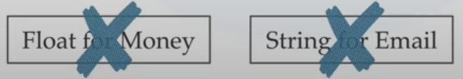
Value Objects
One of the best thing about design
E.g. What is a String?
It’s a general purpose value object designed to handle complexities of char arrays.
Value objects reduces complexity and forces Ubiquitous language.
Feature of a Value Object?
Don’t care about uniqueness
Always immutable
Thread safe
Rich domain logic
Auto – validating
Strong equality

Slide 24
Tactical Design

Slide 25
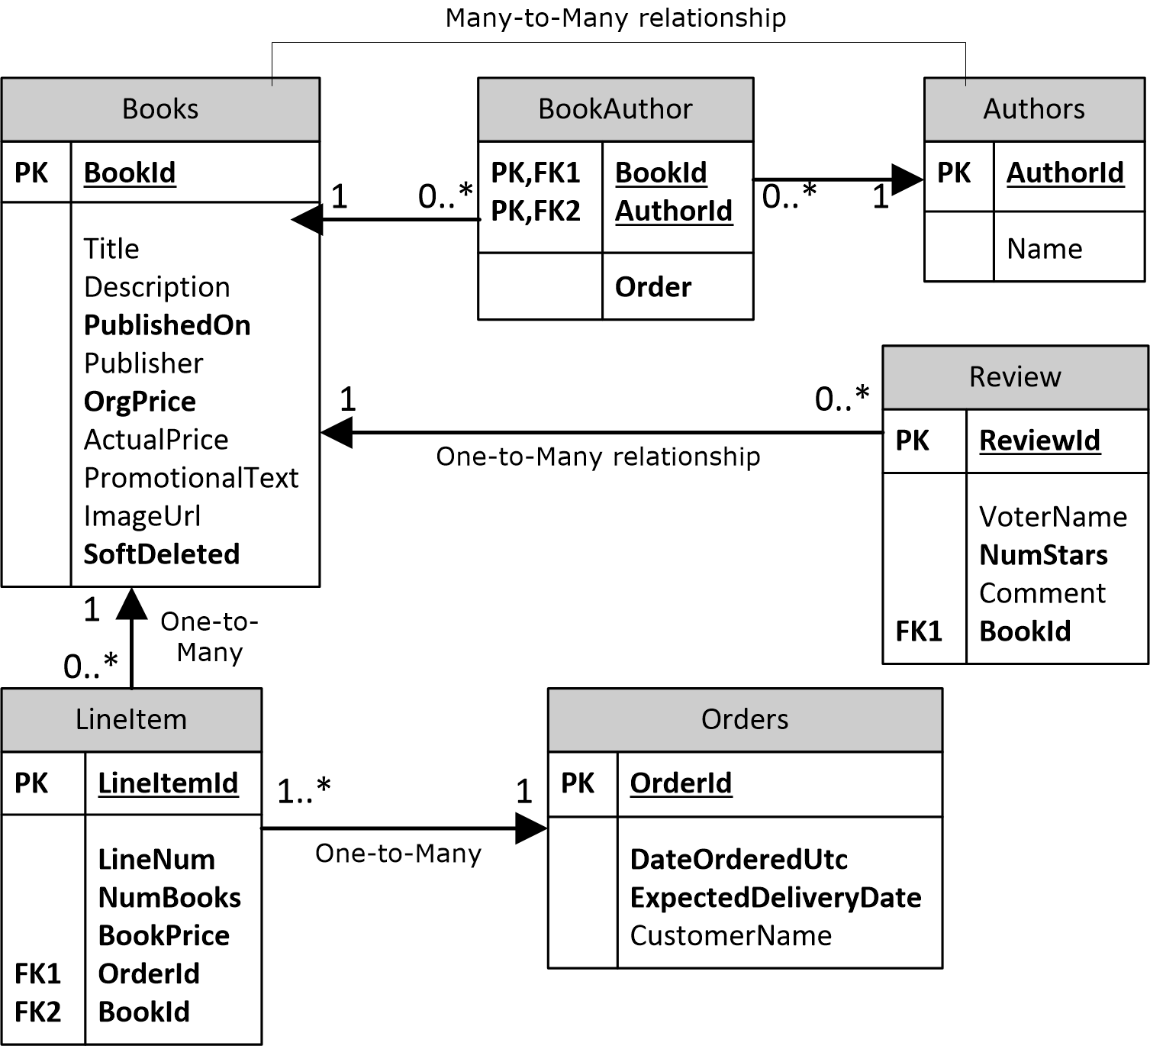
Entities
Can be uniquely identified using an ID.
Consists of value objects.
Generally persisted as a row in DB.
Typically mutable.
Generally implements some business logic.

Slide 26
Tactical Design

Slide 27
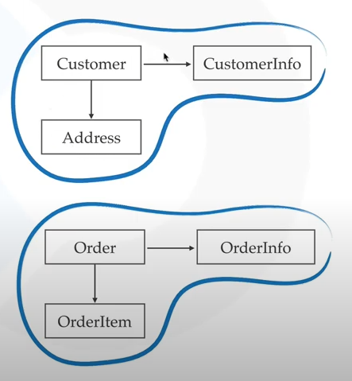
Aggregates
When the object graph becomes big it becomes difficult to maintain
An aggregate is collection of entities and values which comes under a single transaction boundary.
An aggregate controls the change.
An aggregate always has a root entity, which is exposed to outside world.
Root entity governs the lifetime of other entities in aggregate.
An aggregate is always consistent.
Domain events are generated to ensure eventual consistency.

Slide 28
Tactical Design

Slide 29


Factories & Repositories
Factories helps you create new aggregates using entities & values.
When the creation logic of aggregate is complex, we should always use factories to abstract that detail.
Repositories helps us get persisted aggregates.
Repositories should be made per aggregate only and not per entity.
Repositories are not DAO.
DAO fetches raw entities, but repositories bind them into aggregates.
Entities & Values
Aggregate

Slide 30
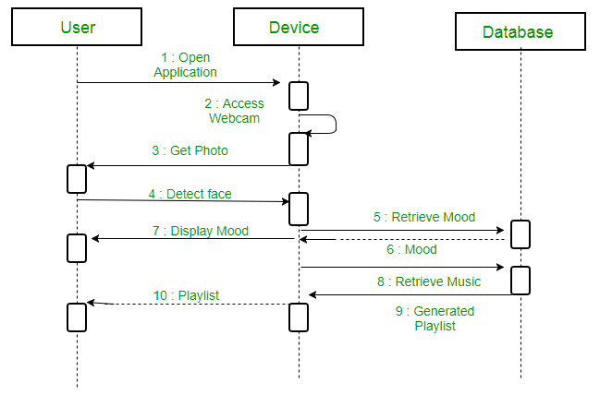
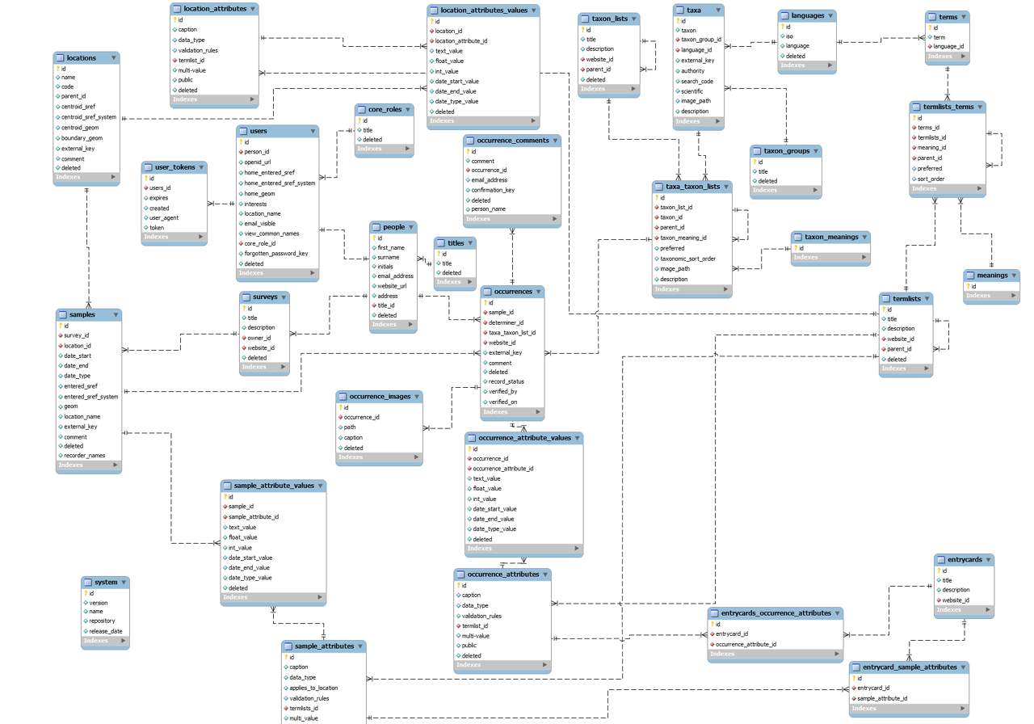
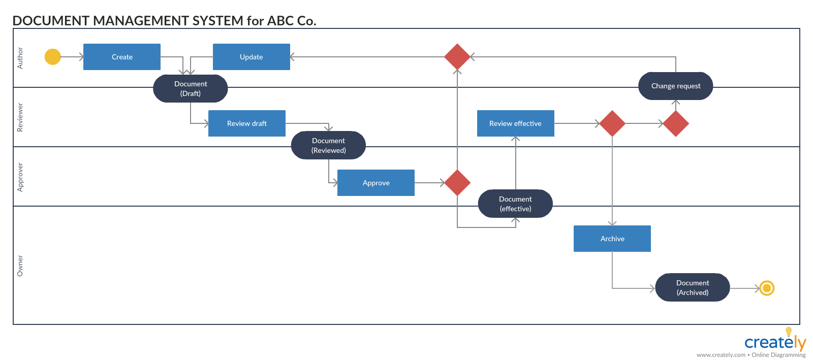
Implementing Strategic DDD
How would you discuss understanding with domain expert ?
May be with the help of use case diagrams or activity diagrams or sequence diagrams or worse ER diagrams.
How would you discuss understanding with domain expert ?
May be with the help of use case diagrams or activity diagrams or sequence diagrams or worse ER diagrams.

Slide 31
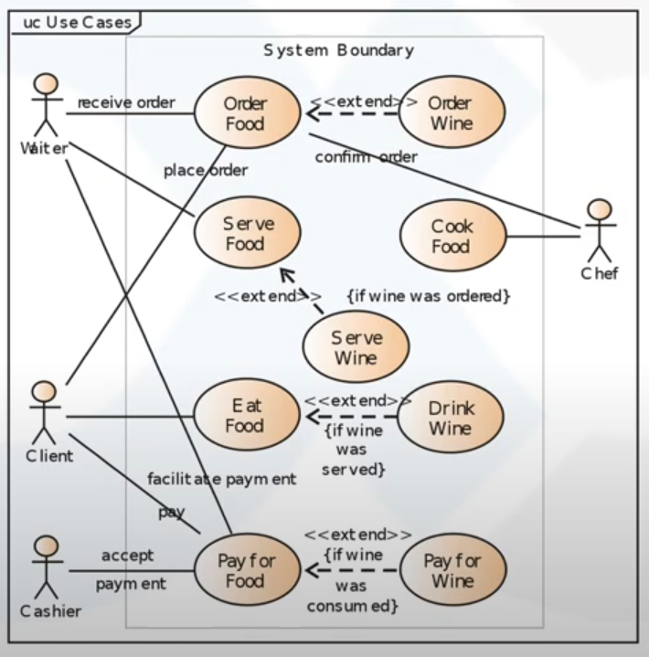
How would you discuss your understanding with domain expert?
Use Case Diagram

Slide 32
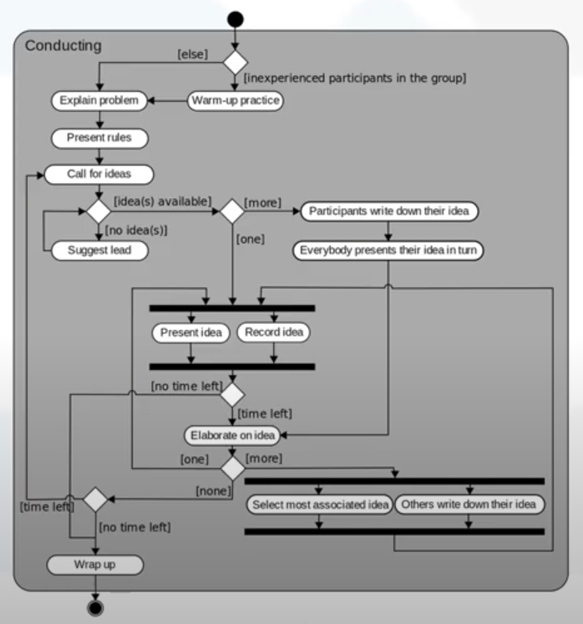
How would you discuss your understanding with domain expert?
Activity Diagram

Slide 33
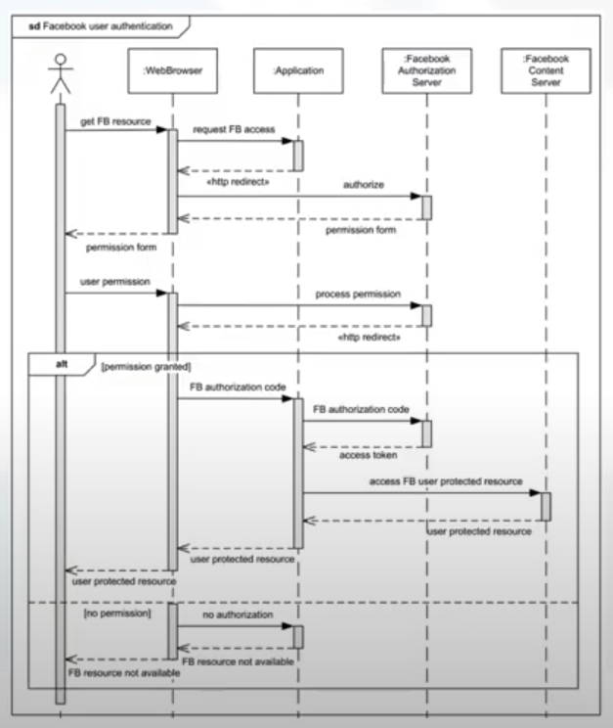
How would you discuss your understanding with domain expert?
Sequence Diagram

Slide 34
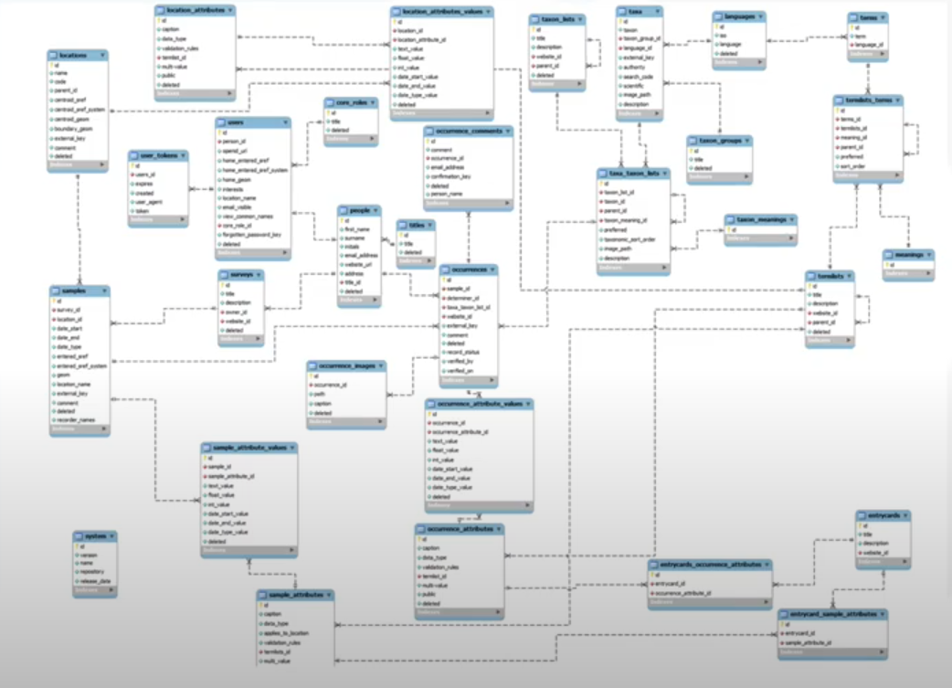
How would you discuss your understanding with domain expert?
ER Diagram ?

Slide 35
Event Storming
An exercise for creating Domain Models for strategic design.
In simple words it is a brain storming workshop among domain experts and technology people to understand the events in a system.
It is aimed to achieve a common understanding of the domain in which software must operate.

Slide 36
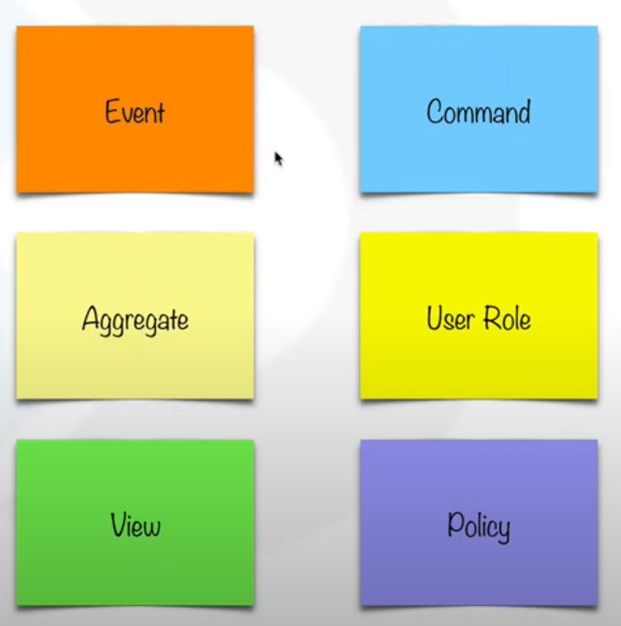
How does event storming work?
First bring the right people in
Then take sticky notes and color code them to events, commands, policies, processes, errors, roles and aggregates etc.

Slide 37
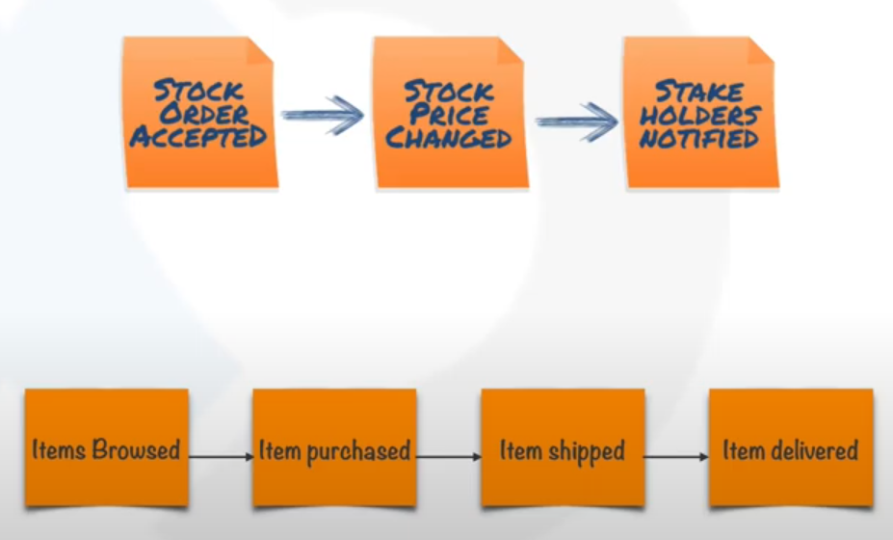
How does event storming work?
First bring the right people in
Then take sticky notes and color code them to events, commands, policies, processes, errors, roles and aggregates etc.
Take a white board and start writing interesting events in sequence

Slide 38
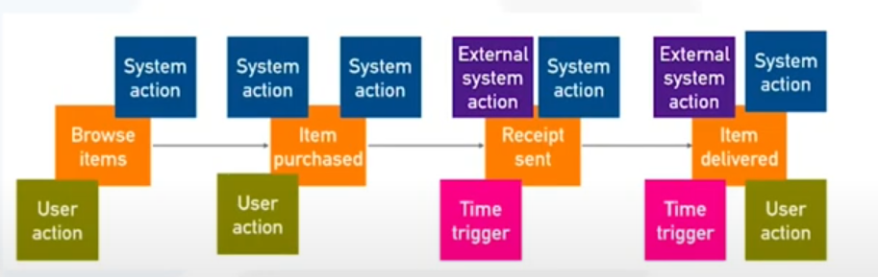
How does event storming work?
First bring the right people in
Then take sticky notes and color code them to events, commands, policies, processes, errors, roles and aggregates etc.
Take a white board and start writing interesting events in sequence
Then start adding commands, aggregates, policies etc.

Slide 39
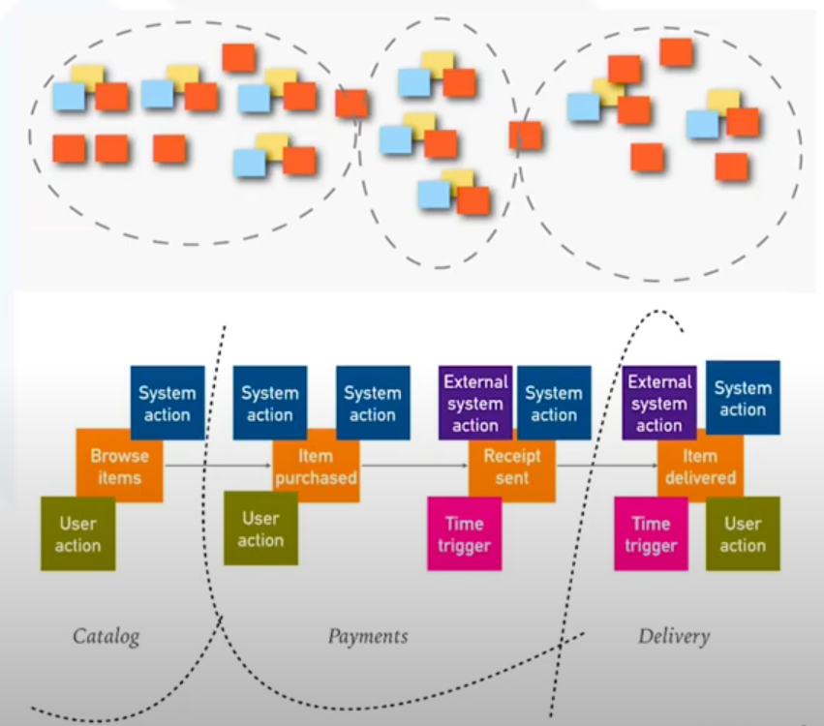
How does event storming work?
First bring the right people in
Then take sticky notes and color code them to events, commands, policies, processes, errors, roles and aggregates etc.
Take a white board and start writing interesting events in sequence
Then start adding commands, aggregates, policies etc.
After the first pass, start identifying bounded contexts

Slide 40
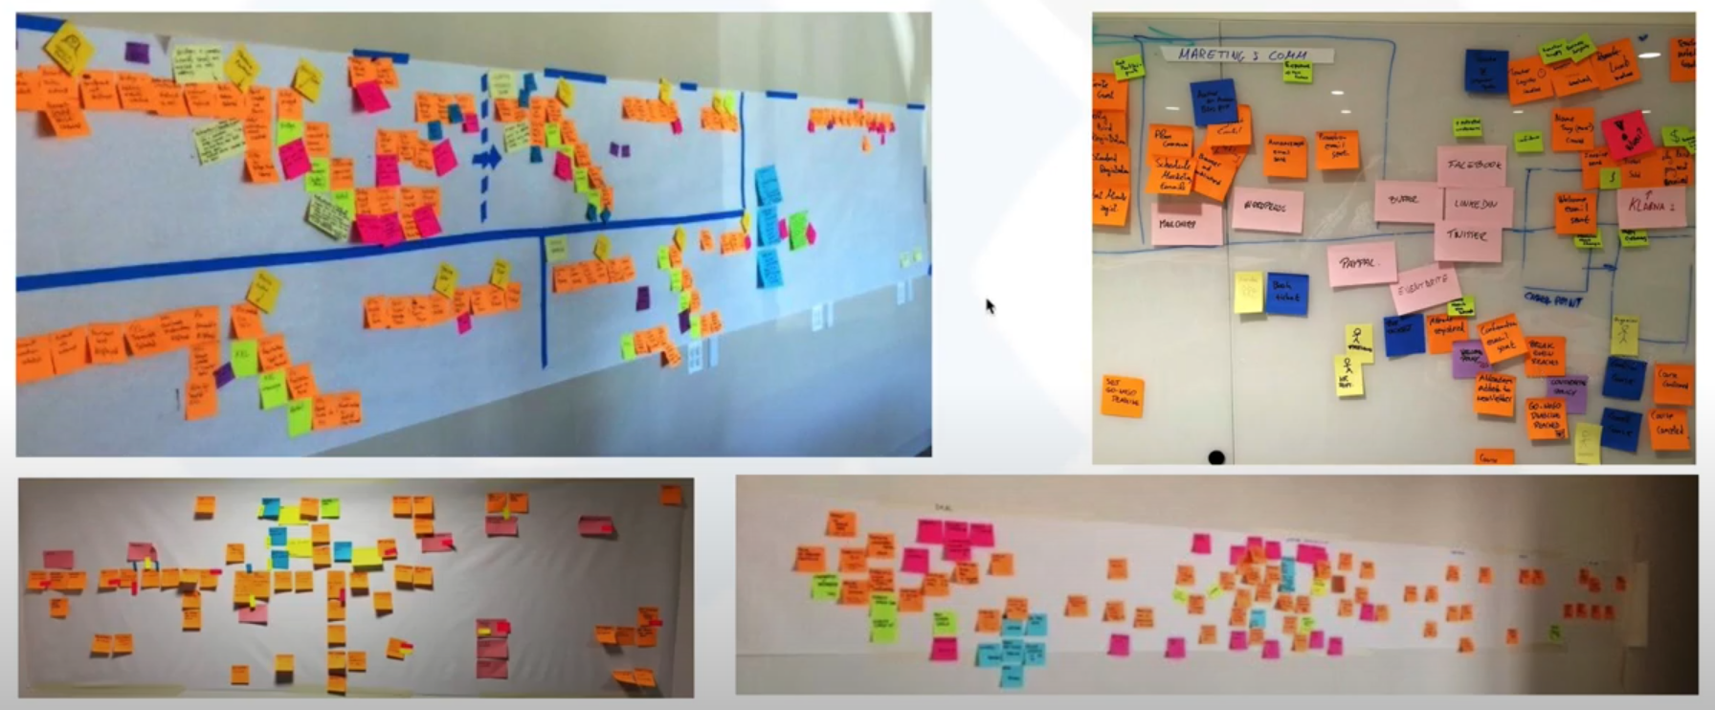
Real life examples

Slide 41
Implementing DDD

Slide 42
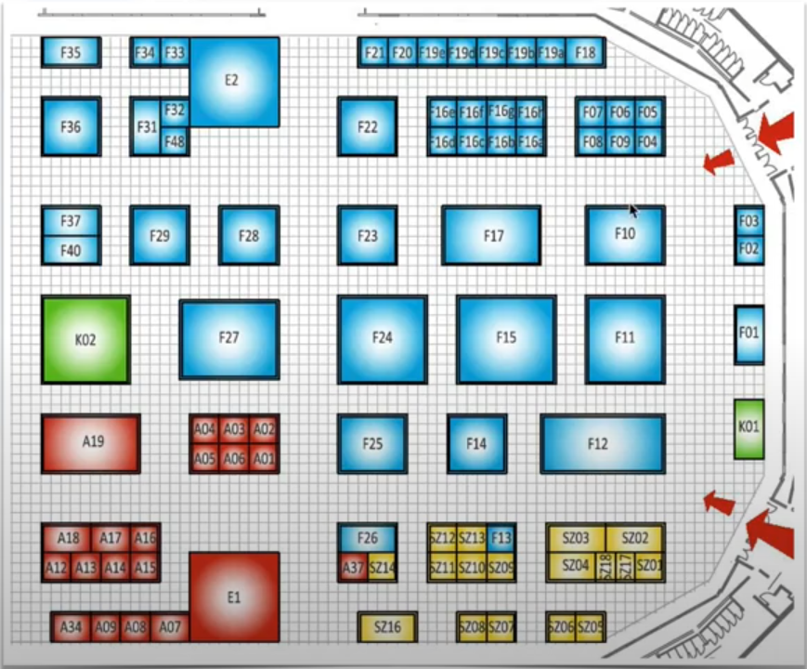
Trade Fair Analogy
Suppose we only check entry ticket at main gates and do profession checking in every room:
Inefficient
Insecure
Complex
Hard to maintain
Solution:
Instead do profession checking at the gate and wrap colored bands to each person’s wrist

Slide 43
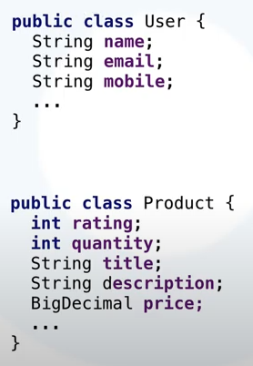
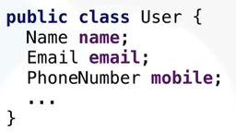
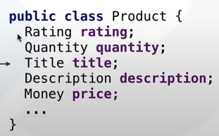
Value Objects aka Domain Primitives

Slide 44
Implementing DDD in code

Slide 45
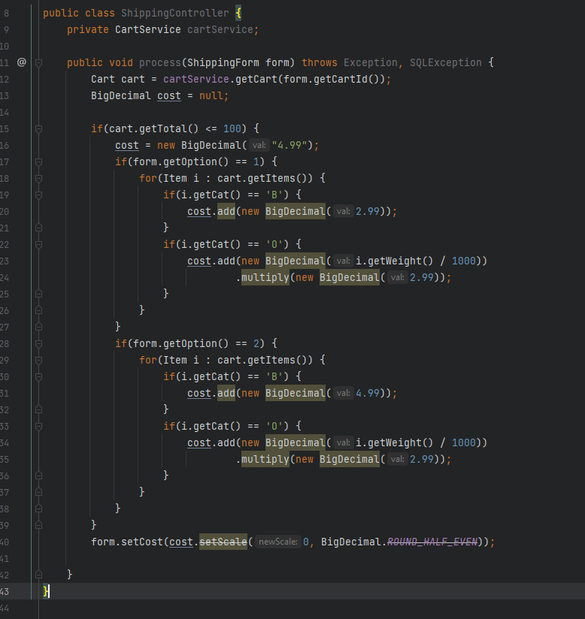
Magic Numbers
Duplicate Code
Primitive Obsession
Mixed Concerns

Slide 46
Implicit Concerns
Free shipping if greater than 100. 100 what?
Free shipping cost?
Currency?
Weight in Gm? Variable cost of each sent KG?
What’s option? Shipping option?
Variable cost per category?

Slide 47
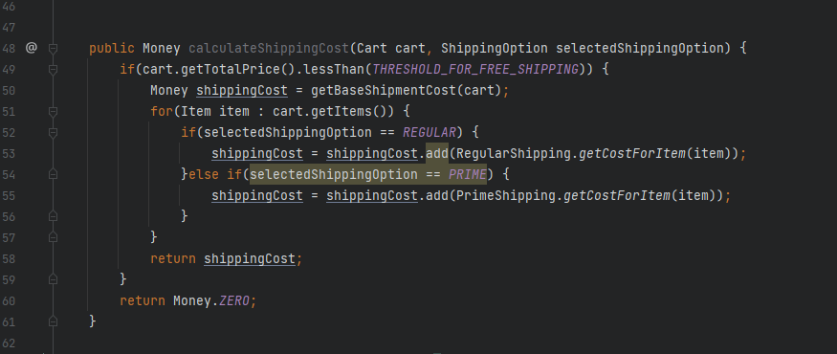
Domain Driven Code

Slide 48
DDD: Wrap Up
What did we learn ?

Slide 49
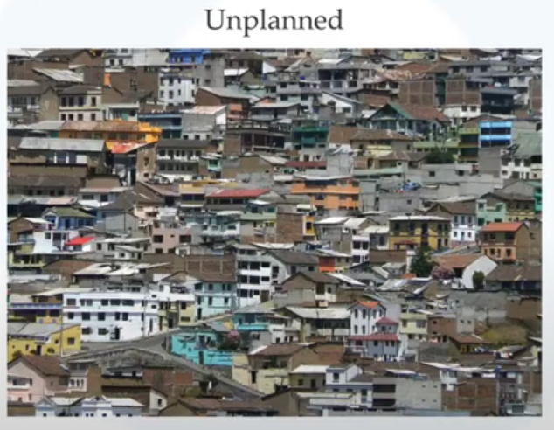
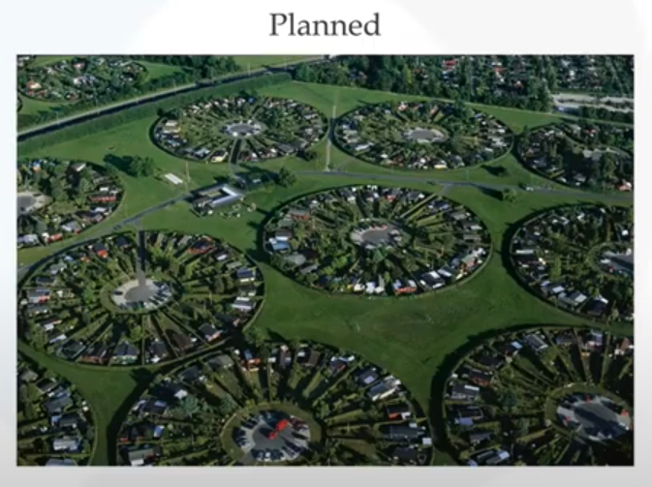
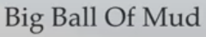

Designing a city analogy

Slide 50
What did we learn ?
Always design your software's in Top-Down fashion, unless your domain is trivial
Focus on what distinguishes you competitors and understand what you must excel at
Always focus all your energy and resources in your core sub-domain
Don’t chase shiny objects by throwing technology at business problems
Place emphasis on naming and operations

Slide 51
Few Conclusions
Don’t work for a company that thinks of software as a cost center
DDD will look just like OOP when you get the hang of it
Don’t create heavy weight blueprints before development, follow an evolutionary approach
Your code and documentation should represent the domain
Build a product for which you can provide long term warranties

Slide 52
Q & A
Thank you

Slide 53
Monoliths

Slide 54
Problem Statement
Develop a server-side enterprise application.
It must support a variety of different clients including desktop browsers, mobile browsers and native mobile applications.
It might also integrate with other applications via either web services or a message broker like payment gateways and notification services.
The application handles requests (HTTP requests and messages) by executing business logic,
Accessing a database, exchanging messages with other systems, and returning a JSON response.

Slide 55
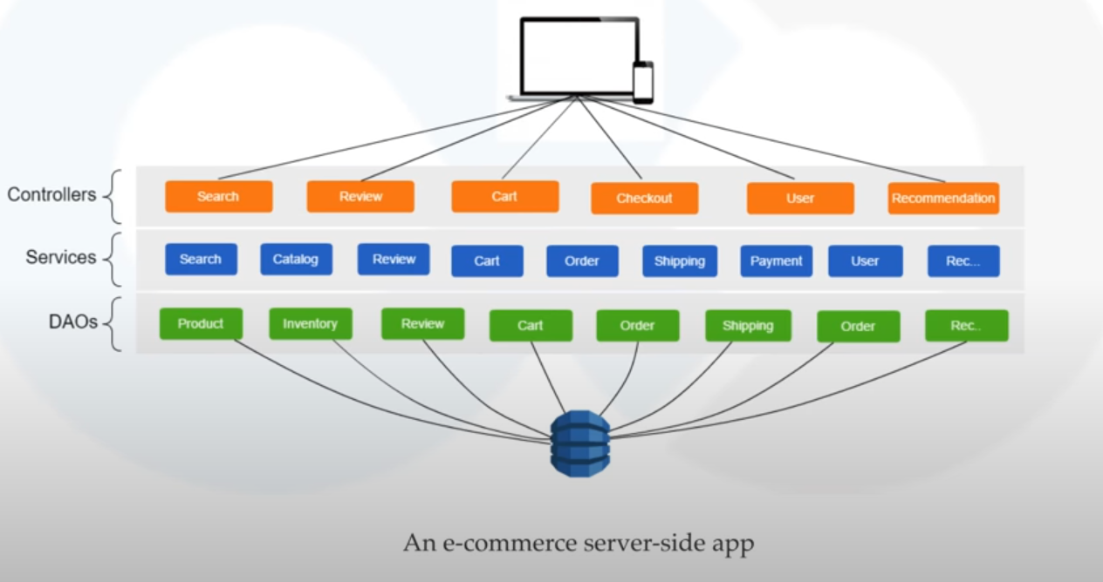
Traditional Server-Side App

Slide 56
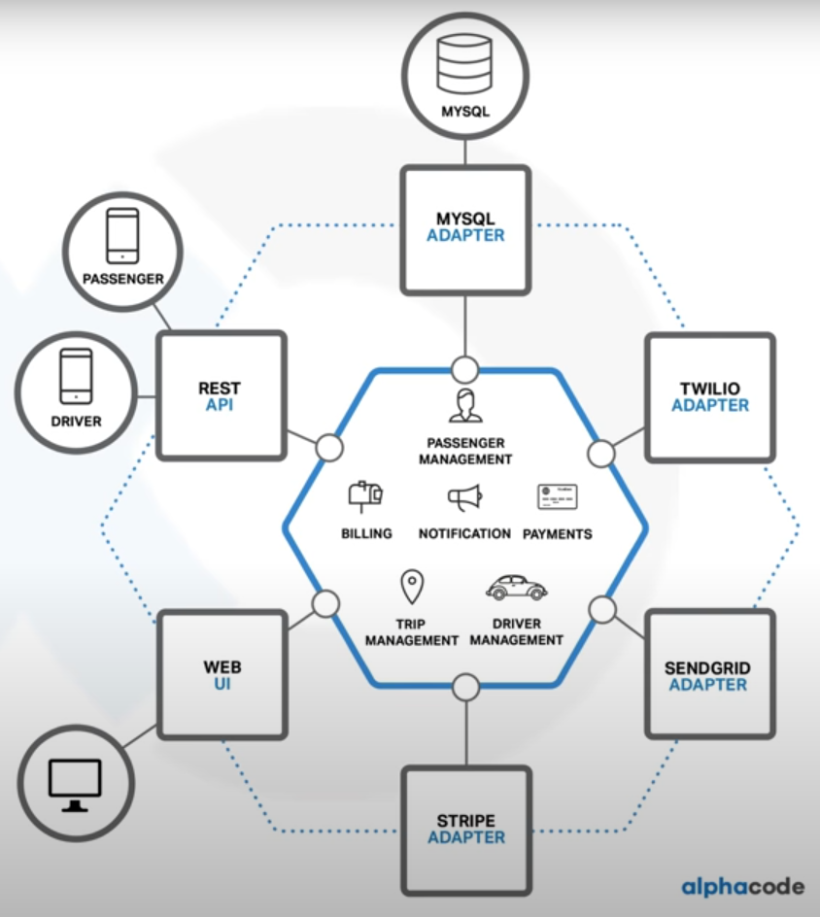

A taxi booking server-side app
Traditional Web-App

Slide 57
Advantages
Simple to develop
Simple to deploy
Simple to manage
Easy to comprehend
Simple to test
Easy to scale up to some level*

Slide 58
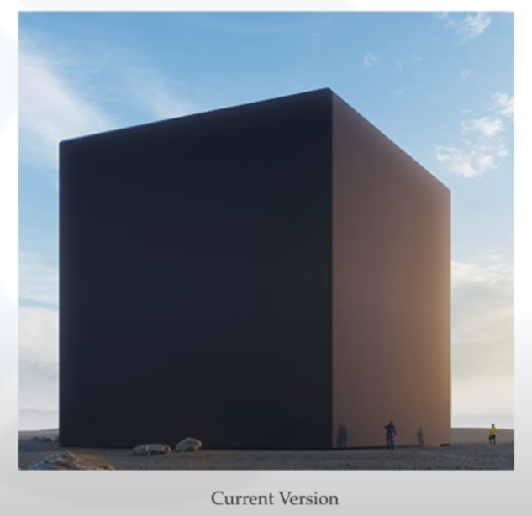




Disadvantages

Slide 59

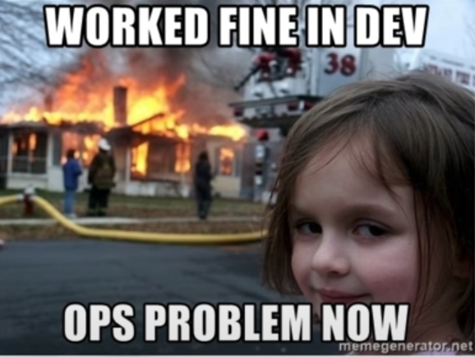
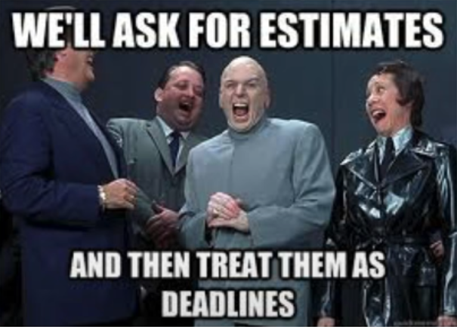

Disadvantages
Language / Framework lock
Difficult to digest
Difficult to distribute development
Deployment as a single unit
Development slows down
Resources are not optimized
Scaling becomes difficult

